Slide 1
Final presentation of Project : Library Management System Course - CS 401 Modern Programming Practices (MPP)
{
}
Presented by –
Group 5
Vijay Manoharan
Dip Ranjon Das

Slide 2
Contents
[Class Model] Use Case Model of the Library System
[Class Model] Checkout done by the Librarian
[Sequence Diagram] Checkout Book
[Sequence Diagram] Add Book
[Validation Rules] Data validation rules of UI Windows
[Extra Use Cases] – 1 Populating individual members checkout record
[Extra Use Cases] – 2 Populating overdue publication list
[Repository] – Github Link
SCI Knowledge

Slide 3
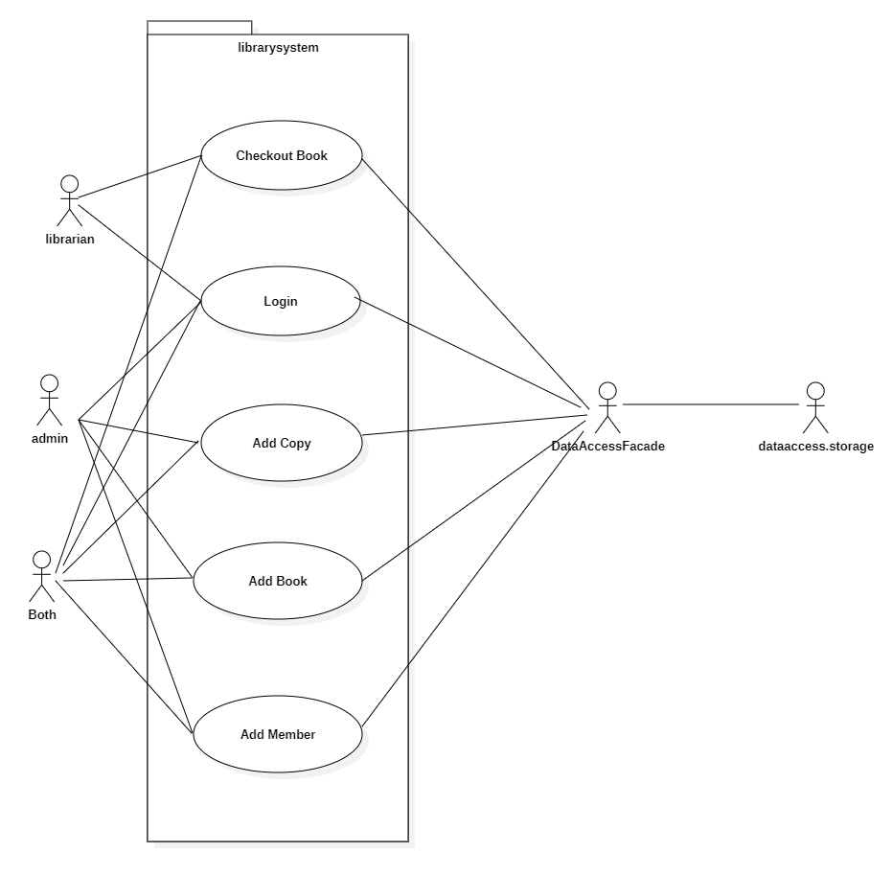
[Class Model] Use Case Model of the Library System

Slide 4
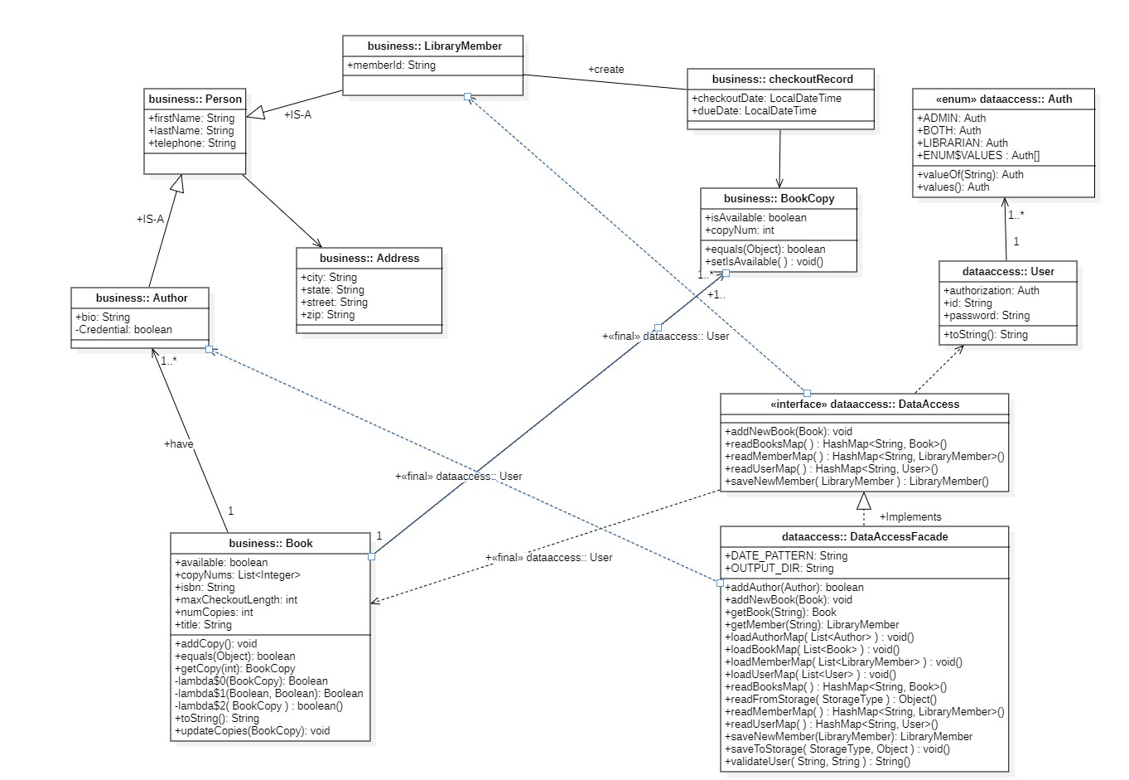
[Class Model] Checkout done by the Librarian

Slide 5
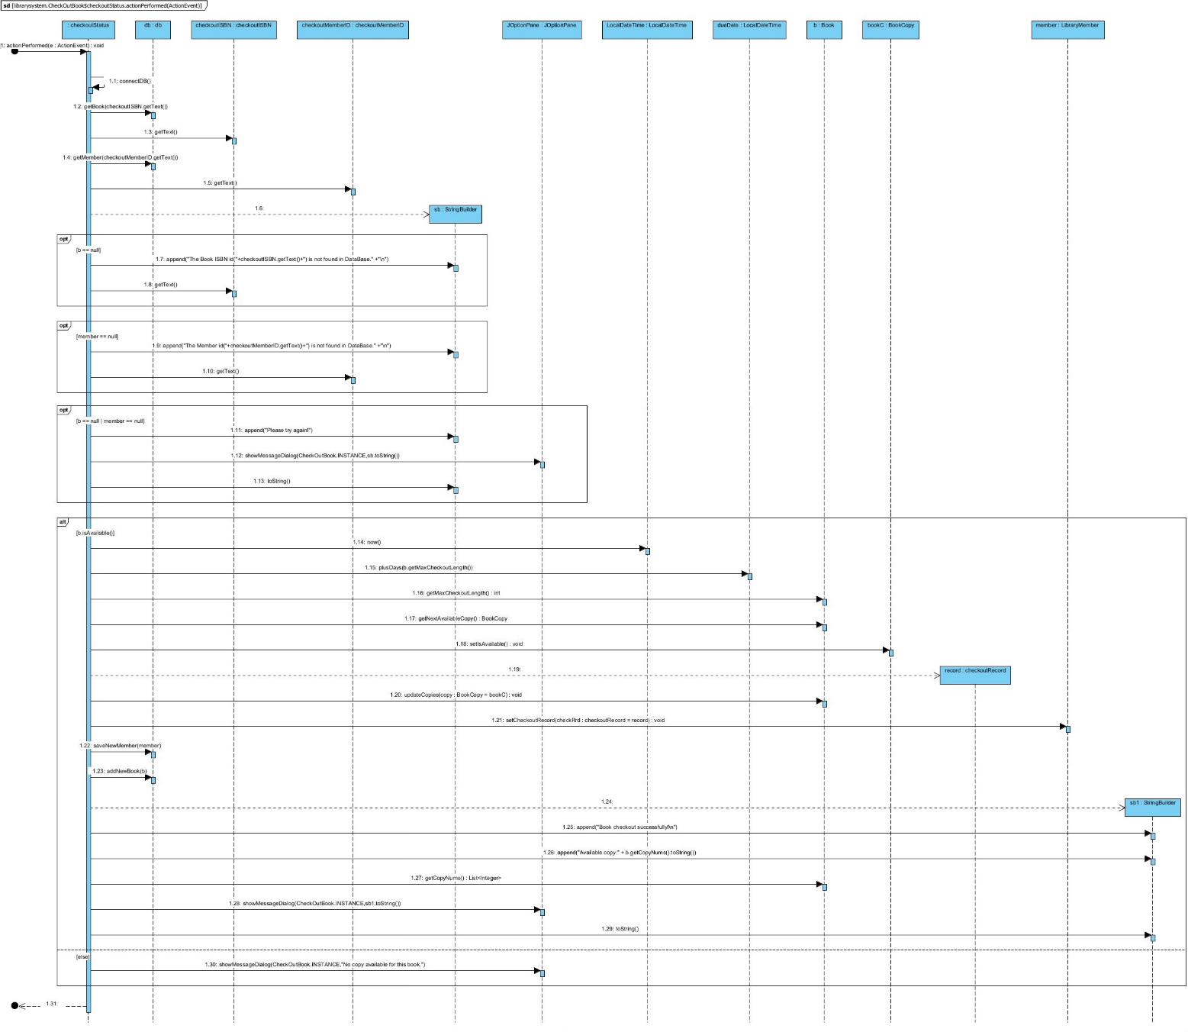
[Sequence Diagram] Checkout Book

Slide 6
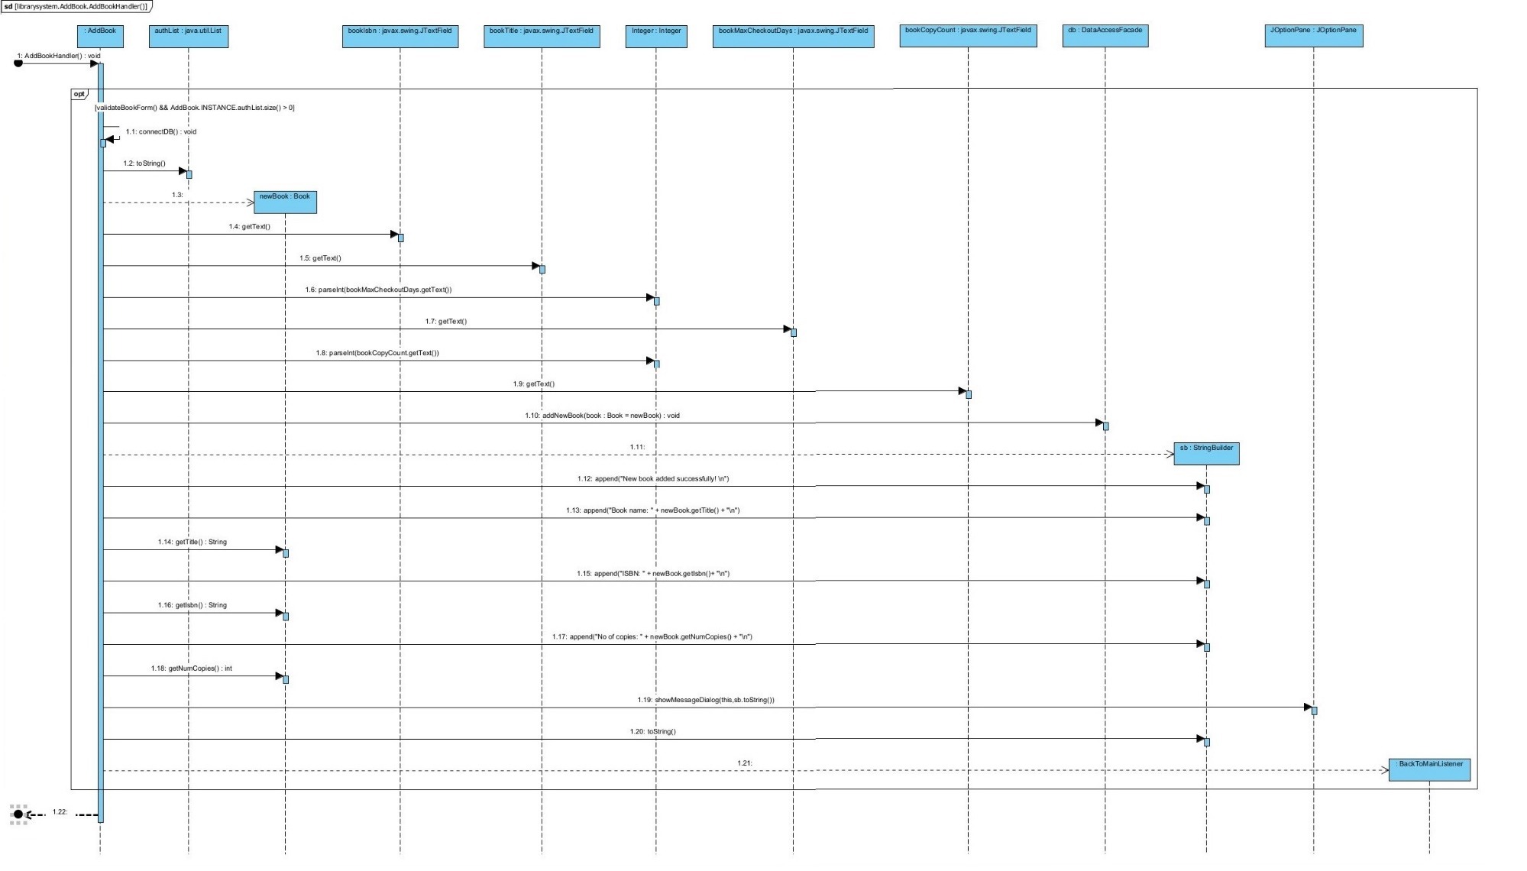
[Sequence Diagram] Add Book

Slide 7
[Validation Rules] Data validation rules of UI Windows
Add Member - UI/ Edit Member
Member ID: Auto Incremented
FirstName: Not Blank
LastName: Not Blank
Street: Not Blank
City: Not Blank
State: Not Blank
ZIP: Five Digits
Phone Number: 10 Digits
Add an Author - UI
FirstName: Not Blank
LastName: Not Blank
Street: Not Blank
City: Not Blank
State: Not Blank
ZIP: Five Digits
Phone Number: 10 Digits
Credentials: True/False
Short Bio. – No Validation
Add Book - UI
Book Title: Not Blank
ISBN Number: Not Blank
Avaiability: True/false
Copy Count: At least 1
Checkout a Book- UI
ISBN Number: Is exist in Database
Member ID: Not Blank

Slide 8
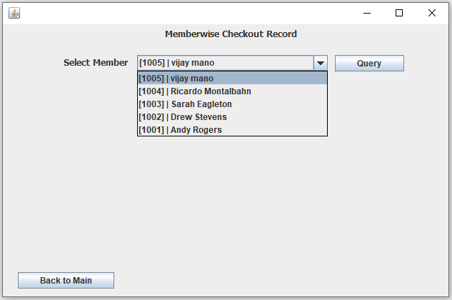
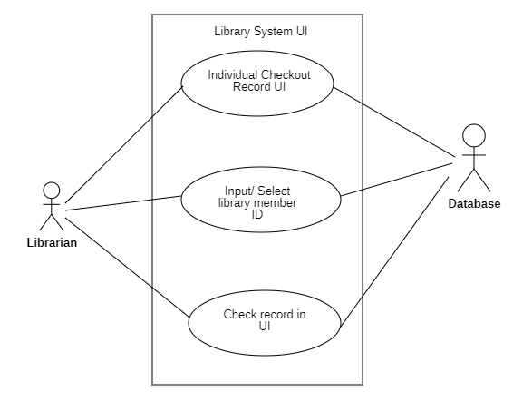
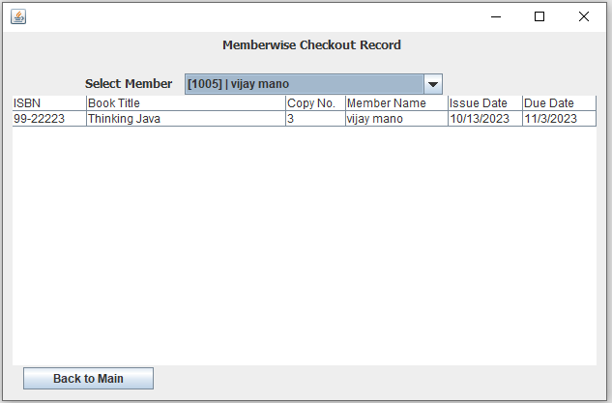
[Extra Use Cases] - 1 Populating individual members checkout record
Figure: Extra Use Case 1
Figure: Implementation

Slide 9
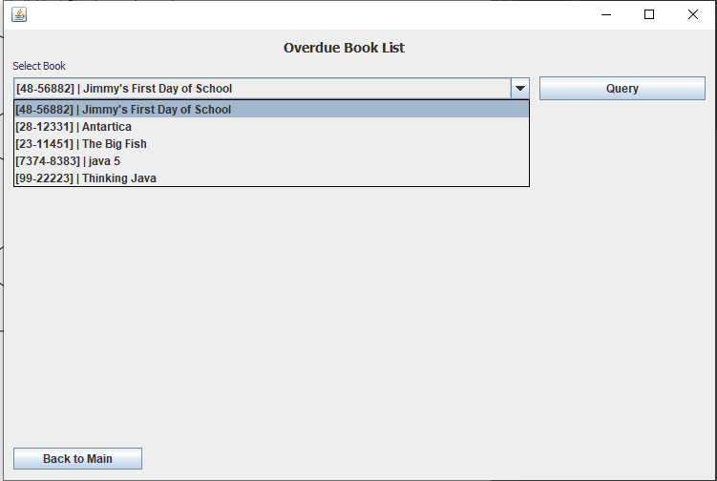
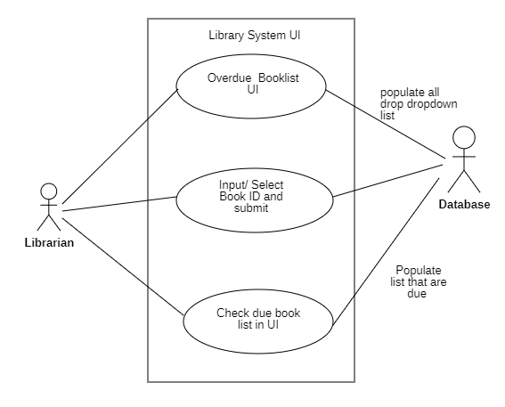
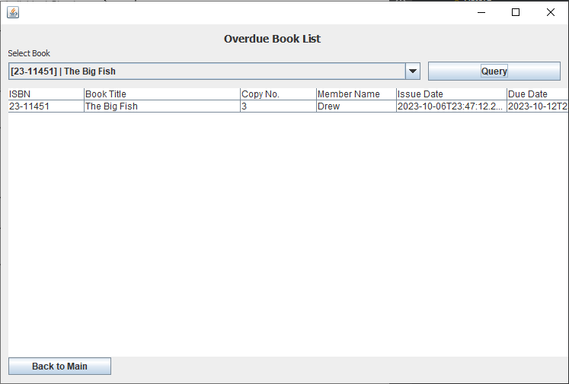
[Extra Use Cases] - 2 Populating overdue publication list
Figure: Extra Use Case 2
Figure: Implementation

Slide 10
Connecting the Parts of Knowledge With the Wholeness of Knowledge
Our developed library management system is built in layers and modules. Business, Data, Data access and library-system (UI) all together forms the library management System.
In real world Life is found in Layers. Different layers of life interact with each other to create the physical structures.
Different layers (Business, Data, Data access and library-system (UI)) of Library management system communicates with each other through function calls. Each layer interacts with the other through different techniques like Inheritance, Association, Composition etc. System data can be only accessed through UI.
In Unity Consciousness, one feels intimately associated with all other things in creation as a result of perceiving all things in terms of one’s Self. The unified field can only be accessed through Transcendental Consciousness.

Slide 11

[Repository]
Github Link
https://github.com/vijay9711/MPP_Project

Slide 12
Thank You!

